Slide 1


Abdelkarim
Abdelkarim
Abdelkarim
Fullstack | Mobile | Desktop
Notes:
This is an introductory video of me & my channel.
Hello, Name’s Abdelkarim, and I am a Fullstack web / mobile / desktop apps developer.
I have almost 11 years of total experience in computer science field.

Slide 2



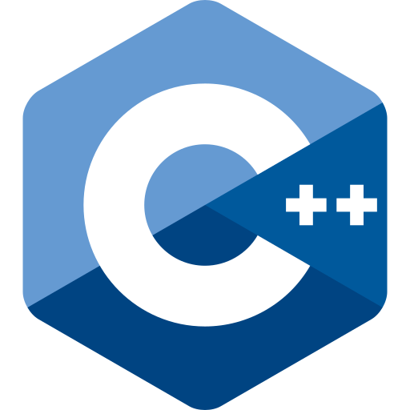


Abdelkarim
Abdelkarim
Abdelkarim
Fullstack | Mobile | Desktop
https://iamkarim.me
Notes:
Along my years of experience, I worked with …. You name it.

Slide 3
React Craft
Learn by doing to escape tutorial hell and work on real world scenario projects.
Notes:
Are You stuck in tutorial hell ? Do You want to code instead of just chucking in knowledge ?
Do you find it hard to finish the design of a website to start coding it ?
Do you think it is difficult to find the right assets (images, fonts …)
I specifically created this channel to help with that.
All the projects in this channel will be provided with a Figma design file and all the assets you need to follow along.

Slide 4
See You In a Minute !
See You In a Minute !
See You In a Minute !
Notes:
So, buckle up and pick any project you feel like doing and let’s get coding !

